Slide 1
Lab Session 6 Register File

Slide 2
Register File Read hardware ( 32 registers)

Slide 3
Register File write hardware

Slide 4
Register file using LogiSim
Let size of the register = 4 bits
Number of Registers = 4
Steps involved
Design a 2 to 4 Decoder - use analyse circuit and truth table method
Design MUX ( 4 to 1 multibit ) – use the 4 to1 single bit MUX and expand it to multibit
Drag 4 registers from Logisim toolkit and change their data bits to 4
Drag four AND gates from Logi Sim Toolkit (gate size =narrow, number of input =2)
Connect all the blocks
Implement all circuits in the existing file ( expt 4)

Slide 5
Decoder Design
Go to Project → Analyse circuit
Add S0 and S1 as input
D0,D1,D2 and D3 as output
Go to truth table
Change the output values as per the truth table of 2 to 4 decoder
Build the circuit

Slide 6
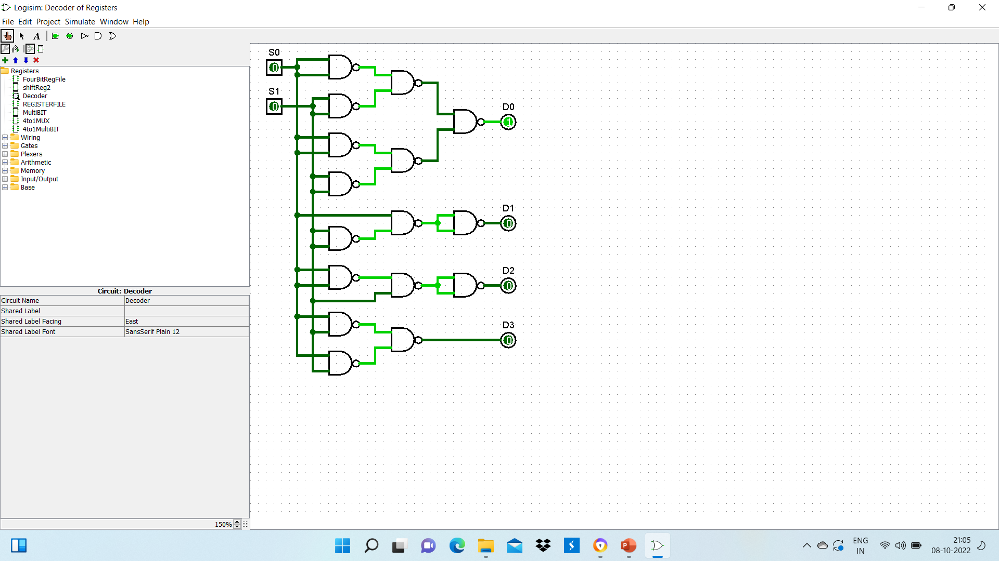
Decoder

Slide 7
Multibit MUX
Project → add circuit
Drag 4 blocks of 4 to 1 single bit MUX
Give four input variables with data bits =4 ( input A,B
Connect the inputs through splitters ( fan out = 4, bit width in =4)
Provide two select inputs S0 and S1 to all blocks
Take the final output through a splitter
Give proper labels to all input and output variables

Slide 8
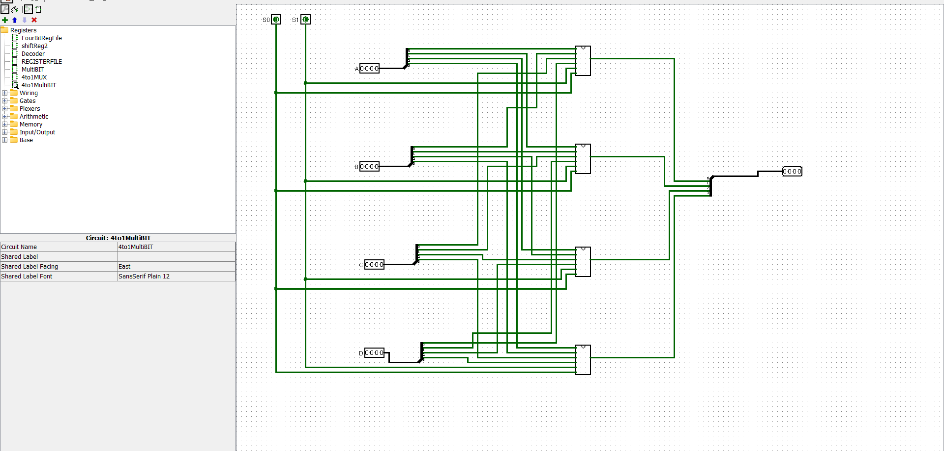
4 to 1 MultiBit MUX

Slide 9
Register File
Drag 4 register blocks from memory folder of Logisim toolkit
Set their data bits =4
Drag 4 AND gates from Gates folder
Drag 1 block of 2 to 4 Decoder
Connect output of AND gate to enable pin of each register
Drag clock input from wiring folder
Connect clock to clock pin of each register ( denoted as a triangle on the block)
Drag 2 units of multibit MUX
Complete the connections

Slide 10
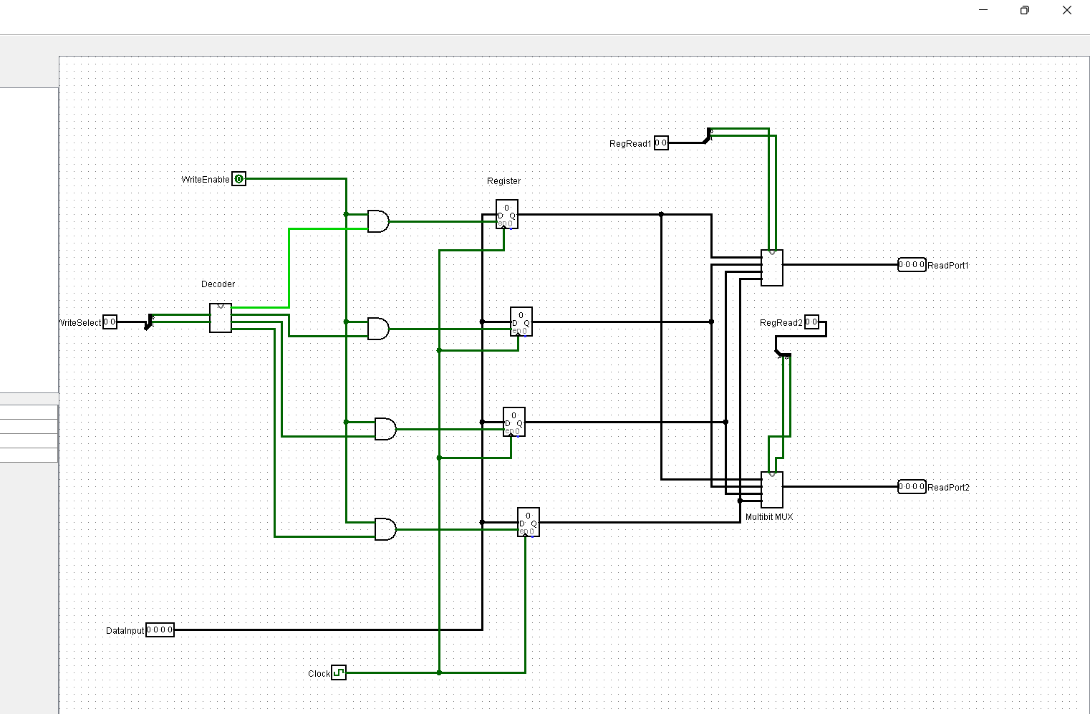

Slide 11
Combining ALU and Register file
Test and verify the register file
Remove the output variables ‘readport1’ and readport2 from the register file
Drag one block of 4 bit ALU
Connect the output of MUX 1 of the register file to 4 bit data input A
Connect the second output to data input B of ALU
Provide 4 bit constant input , Cin and three select inputs for ALU
Provide required output ports for ALU
Test and verify the total circuit

Slide 12
